Slide 1
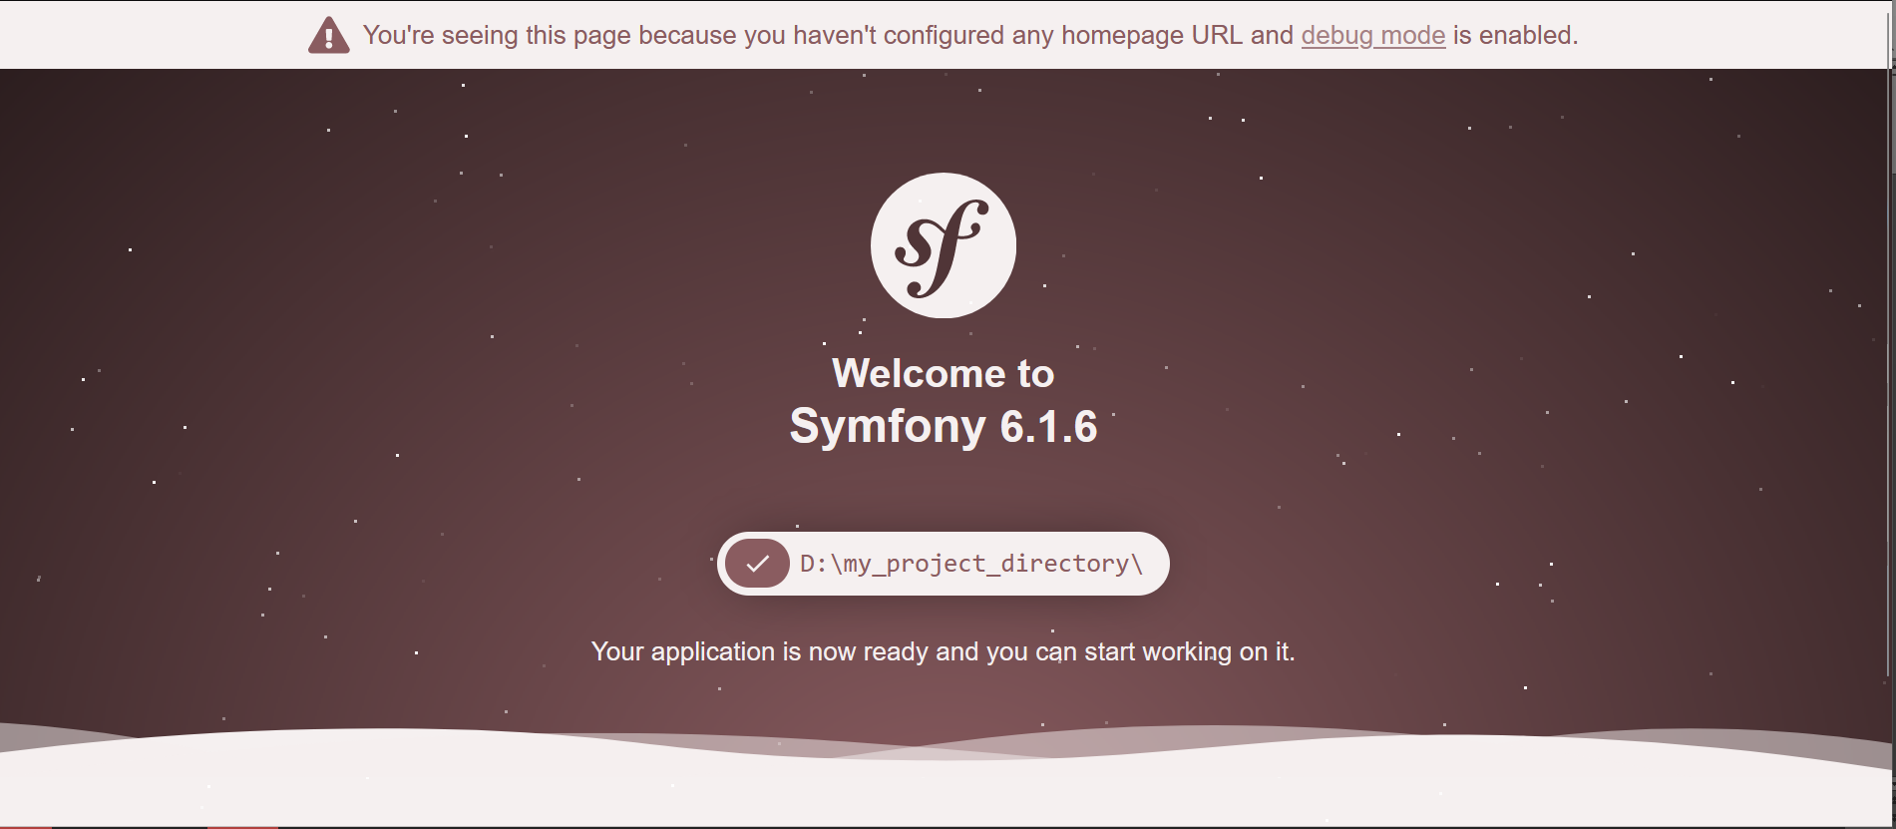
What is Symfony ?
A quick presentation of the Symfony Framework

Slide 2
PRESENTATION
Hello my name is Philippe Da Costa ,future application web designer and developer.

Slide 3
What are we going to talk about?
Framework definition
Prerequisite
Tools
Installation
First project
Project contents
Priricouisite // proiject

Slide 4
Framework definition
First of all, what is a framework ?
A framework is based on an application architecture. It offers a set of coherent tools and software components, such as a reusable software library. Its technical and logical structure requires the developer to respect certain development practices and standards.
Baste //reusabeulle // liebrary.

Slide 5
What is SYMFONY?
Symfony is a Framework that represents a set of standalone PHP components, that can be used in private or open source web projects. But it is also a powerful PHP Framework developed(t) by a French company: SensioLabs.
It aims to simplify the construction of your PHP projects.
For more details on the creators:
https://sensiolabs.com
(also called libraries)
(Check this link) (developed(t) )

Slide 6
Prerequisites...
1: (je regarde les auditeurs)
Before starting with Symfony,
(Je lis)
it is recommended to have a basic knowledge of its language
(je regarde les auditeurs)
which is PHP.
2: (je regarde les auditeurs)
Have some knowledge of HTML /CSS
(je regarde les auditeurs)
3: Have a database installed (my-Sql, MariaDB...)
(Je lis)
4: A PHP version compatible with the symfony version used
example :for Symfony 6 : php8 is required.
Priricouisite // instoll’d // ious’t

